Slide 1

ISearch - Instant Search
CS410 Project
Fall 2018
By Ping Wing Gary Ng

Slide 2
Presentation Outline
Project Overview
Installing the software
Using the software
Examples
Additional information

Slide 3
Project Overview
"ISearch" is a search-as-you-type curses-based search tool implemented in Python (version 3).
Accelerate search process with auto-complete suggestions based on files’ content.
Handles plain text files or PDFs (if file converter is available)

Slide 4
Software installation
Needs Python version 3 installed
Python 3.4 is used during development and testing
pip --install --user metapy autocomplete
git clone https://GitHub.com/pgng2/isearch.git

Slide 5
Using the software
After cloning from GitHub…
$ cd isearch
Start the program using the included 11 text files as text file source:
$ python3 isearch.py
Alternatively, specify a directory for other text files:
$ python3 isearch.py reload ~/other_text_files
The keyword “reload” forces index rebuild and relearning of autocomplete predictive model

Slide 6
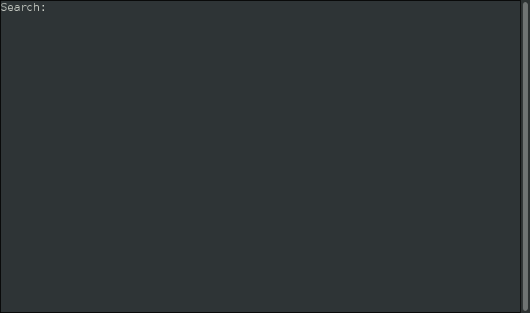
Using the software
After files are index and autocomplete model trained, you’ll see following screen:

Slide 7
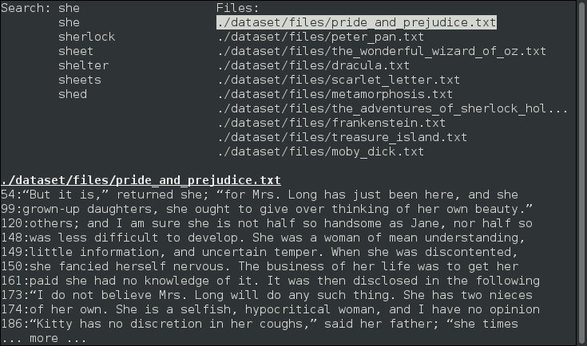
Using the software cont’d
As soon as user starts typing, autocomplete suggestions will be provided and search is performed:

Slide 8
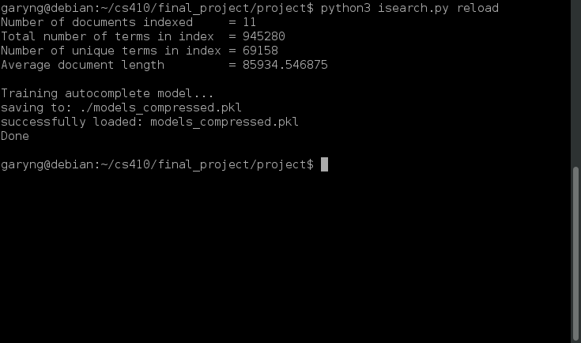
Using the software cont’d
Anytime you want to quit, just hit Ctrl-C

Slide 9
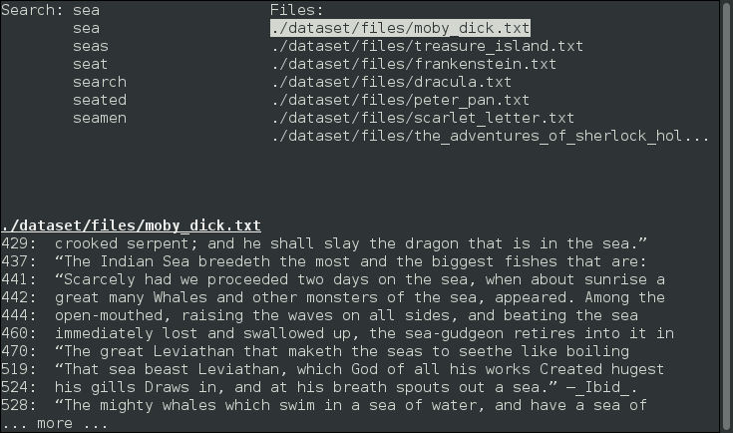
Examples
The sample text files contain some of the famous stories, if I want to find out which of them talk about sea or ocean…

Slide 10
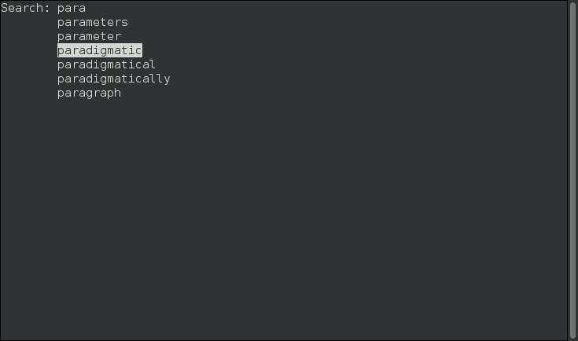
Examples
This example index a different set of text files which are the transcripts of CS410 week 7 – week 12 lectures. I know there’s a concept named something like para… but I don’t remember its spelling and which week it was talked about…

Slide 11
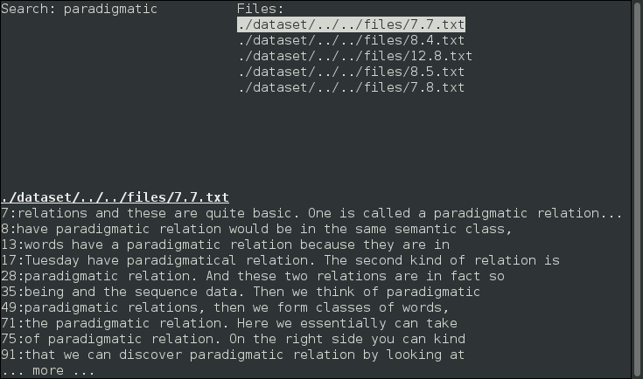
Examples
Right, “Paradigmatic” was the term I was looking for, now if I hit ENTER key I can find out which week’s lecture talks about that…

Slide 12
Additional Information
The software has been uploaded to GitHub and can be cloned from:
https://GitHub.com/pgng2/isearch
Documentation of the software can be found in the project’s README.md file

